Slide 1
Difficulties in Promoting a Just Culture
Arely Gil – Assignment 9.2

Slide 2
What is a Just Culture?
Definition: A balanced approach to accountability that promotes open error reporting and continuous learning while still addressing reckless actions.
Goal: Shift focus from
“Who cause this” to ”What went wrong?”

Slide 3
Organizational & Structural Barries
A culture of blame persists, where fear of disciplinary action prevents people from speaking up.
Established power structures that make it difficult for frontline staff to speak up.
When policies demand punishment for every mistake, they undermine efforts to build a culture of learning.

Slide 4
Cultural & Conceptual Barriers
Organizational culture isn't something that can be instantly designed; meaningful change evolves gradually and often starts at the ground level.
A culture of risk avoidance creates hesitation around failure and experimentation.

Slide 5
Communication & Emotional Barries
Poor communication systems, especially across hierarchical lines, impede transparency.
Fear of job loss or reputational harm discourages open communication in environments lacking psychological safety.
Failing to acknowledge feelings such as guilt and shame after mistakes blocks open dialogue.

Slide 6
Leadership & Policy Barries
Leadership may lack commitment or fail to model just culture values.
Policies may be poorly aligned, emphasizing punishment over learning and growth.
Regulatory or legal pressures may enforce blame rather than learning

Slide 7
System & Resource Barriers
Under-resourced systems: staffing shortages, poor tools, limited time to investigate errors.
Systems not built for transparency or data collection pose barriers to accountability and learning.

Slide 8
Cultural Challenges Unique to DevOps
Divisions between teams prevent effective cross-functional collaboration and learning.
Without strong backing from key stakeholders, including leadership and established teams, change initiatives struggle.

Slide 9
Overcoming the Barriers
Leadership & Modeling - integrate just culture into policies and training
Promote psychological safety: encourage speaking up without fear
Redesign processes: build feedback loops, remove punitive policies
Invest in resources & tools: error tracking, cross-team communication
Align DevOps practices: foster cross-functional teams, reward learning from failure

Slide 10
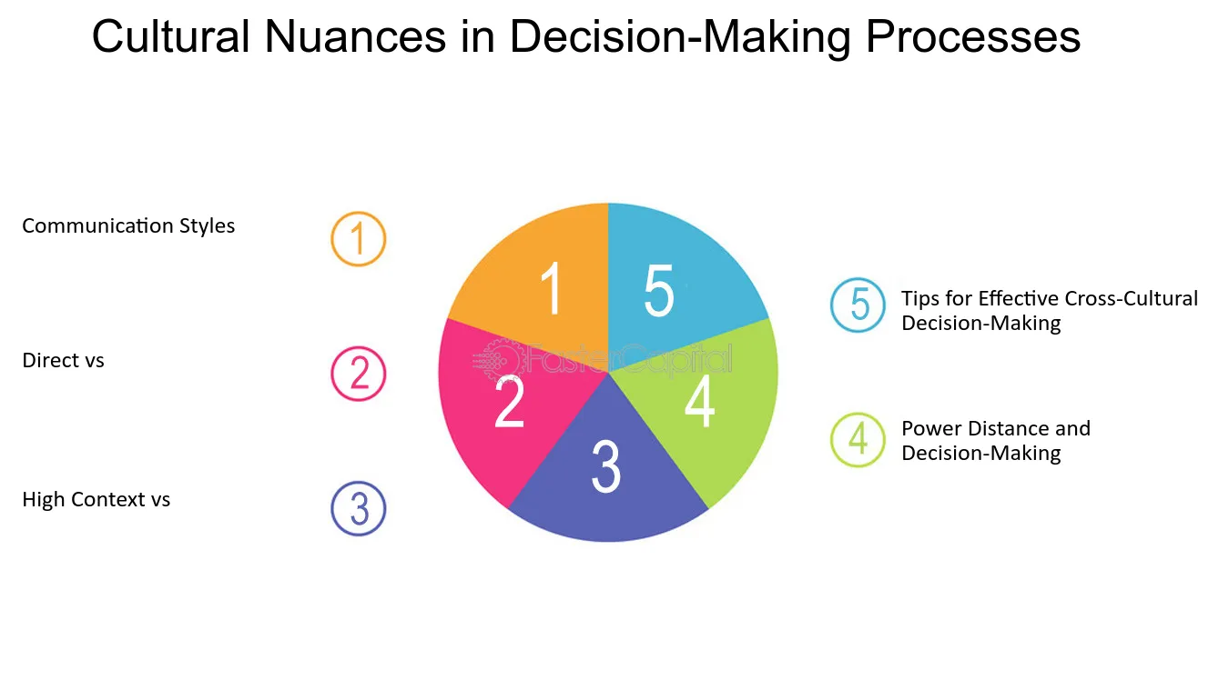
Mapping out the nuanced decision processes involved in implementing a just culture.

Slide 11

References:
https://bmcpsychology.biomedcentral.com/articles/10.1186/s40359-024-02202-w
https://humanisticsystems.com/2023/10/18/why-is-it-just-so-difficult-barriers-to-just-culture-in-the-real-world/
https://www.ihi.org/sites/default/files/Leading_a_Culture_of_Safety_Blueprint.pdf

